Slide 1

Root-x Secure: Safeguarding the Digital Landscape
In today's interconnected world, robust cybersecurity is not optional; it's essential. Root-x Secure provides comprehensive solutions to proactively protect your business from evolving threats.
dd
by dima dima

Slide 2
The Need for Comprehensive Cybersecurity
Growing Threats
Devastating Consequences
Cyberattacks are becoming increasingly sophisticated and frequent, targeting everything from websites to financial institutions.
Data breaches and DDoS attacks can lead to significant financial losses, reputational damage, and legal liabilities.

Slide 3
Encryption and Monitoring: Our Approach
Encryption
Monitoring
We utilize advanced encryption techniques to protect sensitive data, ensuring its confidentiality and integrity.
Our 24/7 monitoring systems actively detect and respond to suspicious activity, providing real-time protection against threats.

Slide 4
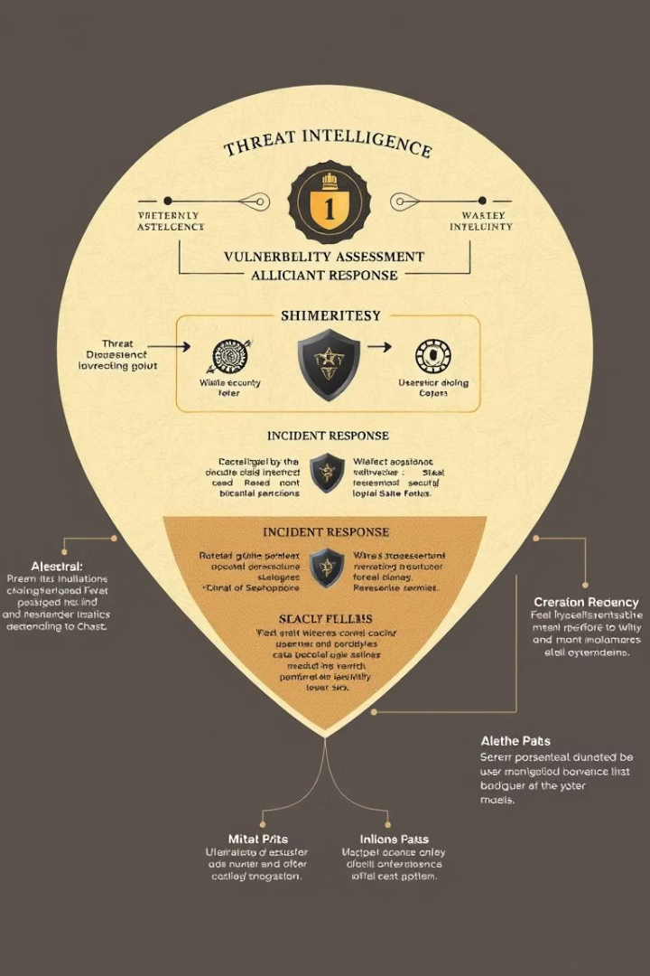
Mitigating Cyber Attacks: Strategies and Solutions
1
Threat Intelligence
2
Vulnerability Assessment
We stay ahead of the curve by continuously monitoring and analyzing emerging threats.
Regular vulnerability assessments identify and remediate weaknesses in your systems and applications.
3
Incident Response
Our team is equipped to respond swiftly to incidents, minimizing damage and restoring operations.

Slide 5
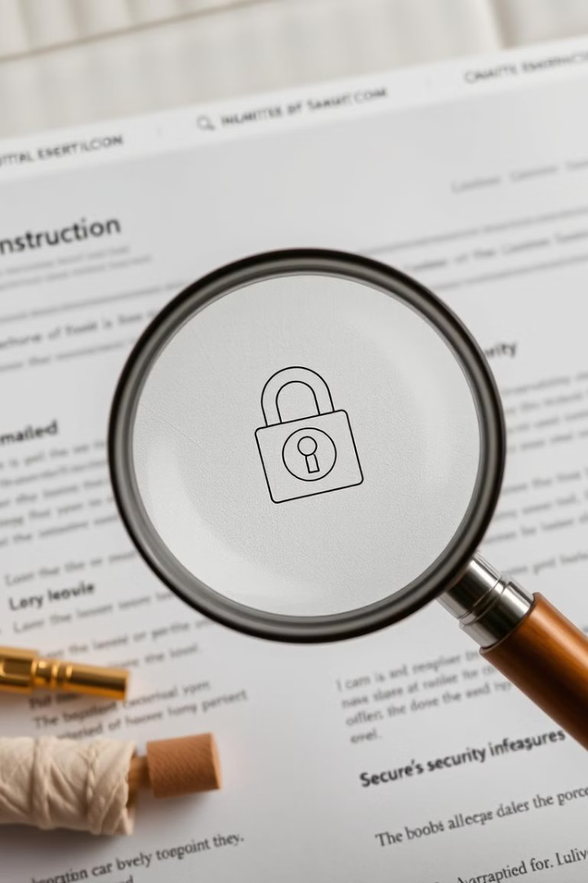
Secure Website Development: Best Practices
Secure Coding Practices
Secure Authentication
We employ rigorous coding standards to minimize vulnerabilities and enhance security.
Strong authentication measures safeguard user accounts and prevent unauthorized access.
Web Application Firewalls
We deploy web application firewalls to protect against common attacks and malicious code.

Slide 6




Proactive Threat Monitoring and Incident Response
Continuous Monitoring
Automated Alerts
Our 24/7 security operations center constantly monitors your systems for suspicious activity.
Automated alerts trigger immediate responses, allowing us to act swiftly in case of a breach.
Incident Response Plan
We have a comprehensive incident response plan in place to minimize downtime and mitigate damage.

Slide 7



Compliance and Regulatory Adherence
1
Industry Standards
2
Compliance Audits
3
Data Protection
We adhere to industry best practices and regulatory standards, ensuring data privacy and security.

Slide 8
Empowering Clients: Tailored Security Services
Needs Assessment
1
We conduct a thorough assessment of your security needs to tailor a customized solution.
Security Solutions
2
We offer a range of security solutions to address your specific vulnerabilities and risks.
Ongoing Support
3
We provide ongoing support and maintenance to ensure your security posture remains robust.

